Slide 1


Keras
Keras for Deep Learning Research

Slide 2
Feedback is greatly appreciated!

Slide 3

Overview
Quick Review of Previous Topics and NNs
Convolutional Neural Networks (CNN)
Hyperparameters of CNN
Image classification with CNN

Slide 4
Let's quickly review what we've covered so far!

Slide 5
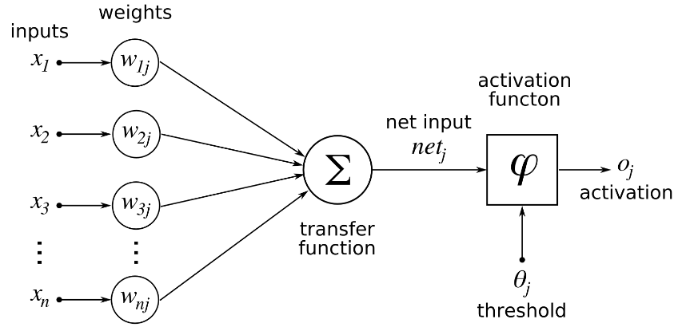
Deep Learning
Single Neuron
We now understand how to perform a calculation in a neuron
w · x + b = z
a = σ(z)
Source: https://www.udemy.com/complete-guide-to-tensorflow-for-deep-learning-with-python/learn/v4/overview

Slide 6
Deep Learning
Activation Functions
Threshold Function/Step Function
Sigmoid
Rectifier
Hyperbolic Tangent(tanh)
Source: https://www.udemy.com/complete-guide-to-tensorflow-for-deep-learning-with-python/learn/v4/overview

Slide 7
Deep Learning
Connecting Neurons to create a network
Source: https://www.udemy.com/complete-guide-to-tensorflow-for-deep-learning-with-python/learn/v4/overview

Slide 8
Deep Learning
Neural Network
Input Layer
Hidden Layers
Output Layer
More layers → More Abstraction
Source: https://www.udemy.com/complete-guide-to-tensorflow-for-deep-learning-with-python/learn/v4/overview

Slide 9
Deep Learning
To "learn" we need some measurement of error.
We use a Cost/Loss Function
Quadratic
Cross-Entropy
Source: https://www.udemy.com/complete-guide-to-tensorflow-for-deep-learning-with-python/learn/v4/overview

Slide 10
Deep Learning
Once we have the measurement of error, we need to minimize it by choosing the correct weight and bias values.
We use gradient descent to find the optimal values.
Source: https://www.udemy.com/complete-guide-to-tensorflow-for-deep-learning-with-python/learn/v4/overview

Slide 11
Deep Learning
We can then backpropagate the gradient descent through multiple layers, from the output layer back to the input layer.
Source: https://www.udemy.com/complete-guide-to-tensorflow-for-deep-learning-with-python/learn/v4/overview

Slide 12
Convolutional Neural Network (CNN)

Slide 13
Convolutional Neural Network (CNN)
Just like the simple perceptron, CNNs also have their origins in biological research.
Hubel and Wiesel studied the structure of the visual cortex in mammals, winning a Nobel Prize in 1981.
Source: https://en.wikipedia.org/wiki/Convolutional_neural_network

Slide 14
Convolutional Neural Network (CNN)
Their research revealed that neurons in the visual cortex had a small local receptive field.
Source: https://en.wikipedia.org/wiki/Convolutional_neural_network

Slide 15
Convolutional Neural Network (CNN)
This idea then inspired an ANN architecture that would become CNN
Famously implemented in the 1998 paper by Yann LeCun et al.
The LeNet-5 architecture was first used to classify the MNIST data set.
Source: https://en.wikipedia.org/wiki/Convolutional_neural_network

Slide 16
Convolutional Neural Network (CNN)
There are four main operations in the CNN
Convolutions and Filters
Pooling or Sub Sampling
Non Linearity
Classification (Fully Connected Layer)
Source: https://ujjwalkarn.me/2016/08/11/intuitive-explanation-convnets/

Slide 17
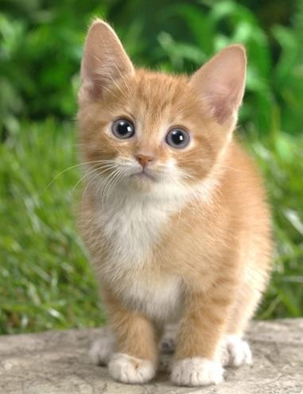






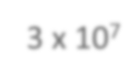





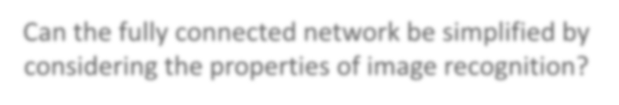


Why CNN for Image?
When processing image, the first layer of fully connected network would be very large
……
……
Softmax
100
3 x 10⁷
……
……
……
100
100 x 100 x 3
1000
Can the fully connected network be simplified by considering the properties of image recognition?

Slide 18
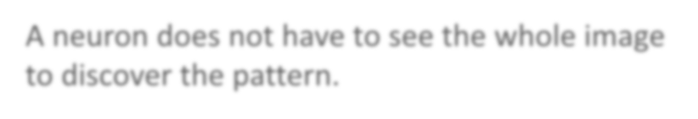


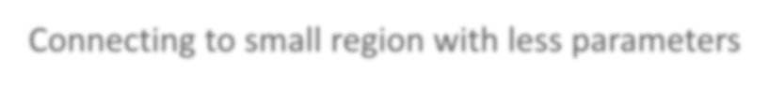

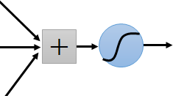
Why CNN for Image
Some patterns are much smaller than the whole image
A neuron does not have to see the whole image to discover the pattern.
Connecting to small region with less parameters
“beak” detector

Slide 19


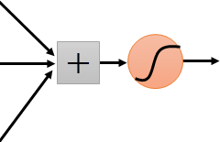


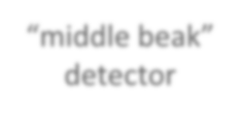
Why CNN for Image
The same patterns appear in different regions.
“upper-left beak” detector
Do almost the same thing
They can use the same
set of parameters.
“middle beak” detector

Slide 20
Convolutions and Filters
The primary purpose of Convolution is to extract features from the input image/text
Convolution preserves the spatial relationship between pixels by learning image features using small squares of input data
Convolution preserves the semantic relationship between words by learning text features using small part of input data
Source: https://ujjwalkarn.me/2016/08/11/intuitive-explanation-convnets/

Slide 21

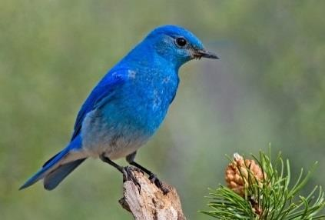
Why CNN for Image
Subsampling the pixels will not change the object bird
bird
subsampling
We can subsample the pixels to make image smaller
Less parameters for the network to process the image

Slide 22


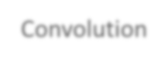

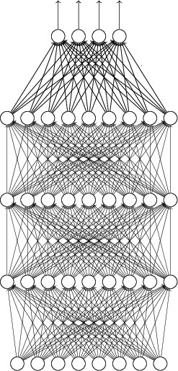
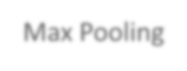

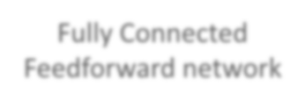


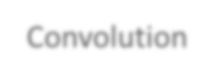

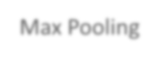

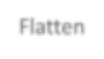


The whole CNN
cat dog ……
Convolution
Max Pooling
Can repeat
many times
Fully Connected Feedforward network
Convolution
Max Pooling
Flatten

Slide 23




The whole CNN
Property 1
Some patterns are much smaller than the whole image
Convolution
Property 2
Max Pooling
The same patterns appear in
different regions.
Can repeat
many times
Property 3
Convolution
Subsampling the pixels will not change the object
Max Pooling
Flatten

Slide 24
The whole CNN
cat dog ……
Convolution
Max Pooling
Can repeat
many times
Fully Connected Feedforward network
Convolution
Max Pooling
Flatten

Slide 25
CNN – Convolution
Those are the network parameters to be learned.
1 | -1 | -1
-1 | 1 | -1
-1 | -1 | 1
1 | 0 | 0 | 0 | 0 | 1
0 | 1 | 0 | 0 | 1 | 0
0 | 0 | 1 | 1 | 0 | 0
1 | 0 | 0 | 0 | 1 | 0
0 | 1 | 0 | 0 | 1 | 0
0 | 0 | 1 | 0 | 1 | 0
Filter 1 Matrix
Filter 2 Matrix
-1 | 1 | -1
-1 | 1 | -1
-1 | 1 | -1
……
6 x 6 image
Each filter detects a small pattern (3 x 3).
Property 1

Slide 26
Convolutions and Filters
Filters are commonly visualized with grids
Sliding across all image by size 3 by 3
0 | 0 | 0 | 0 | 0 | 0
0 | 1 | 1 | 1 | 1 | 0
0 | 1 | -1 | -1 | 1 | 0
0 | 1 | -1 | -1 | 1 | 0
0 | 1 | 1 | 1 | 1 | 0
0 | 0 | 0 | 0 | 0 | 0
0 | 0 | 0
0 | -1 | 1
0 | 1 | -1
0×0 | 0×0 | 0×0
0×0 | 1×-1 | 1×1
0×0 | 1×1 | 1×-1
0 | 0 | 0
0 | -1 | 1
0 | 1 | -1
0
3 by 3 Filter
Multiply by filter weights
Sum the Result

Slide 27
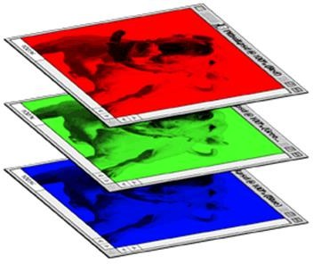
CNN – Colorful image
1
-1
-1
-1
-1
1
1
-1
-1
1
-1
-1
-1 1 -1
1 -1 -1
-1
1
-1
-1
-1
1
1
-1
-1
-1
1
-1
-1 1 -1
Filter 2
-1 1 -1 Filter 1
-1
-1
1
-1
-1
1
1
-1
-1
-1
-1
1
-1 1 -1
-1 -1 1
Colorful image
 |  | 1 | 0 | 0 | 0 | 0 | 1
 |  | 0 | 1 | 0 | 0 | 1 | 0
 |  | 0 | 0 | 1 | 1 | 0 | 0
 |  | 1 | 0 | 0 | 0 | 1 | 0
 |  | 0 | 1 | 0 | 0 | 1 | 0
 |  | 0 | 0 | 1 | 0 | 1 | 0
1
0
0
0
0
1
1
0
0
0
0
1
0
1
0
0
1
0
0
1
0
0
1
0
0
0
1
1
0
0
0
0
1
1
0
0
1
0
0
0
1
0
1
0
0
0
1
0
0
1
0
0
1
0
0
1
0
0
1
0
0
0
1
0
1
0
0
0
1
0
1
0

Slide 28
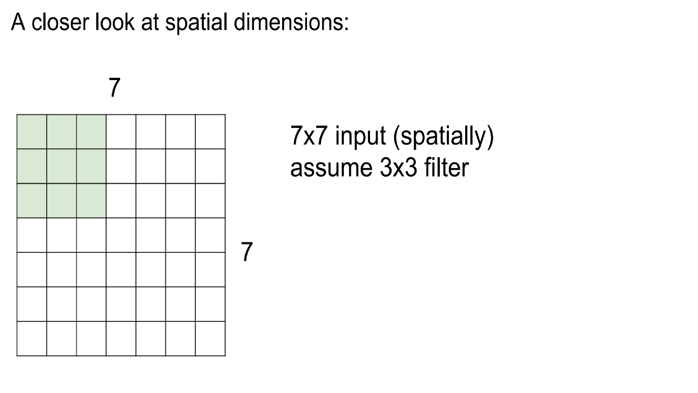

Slide 29
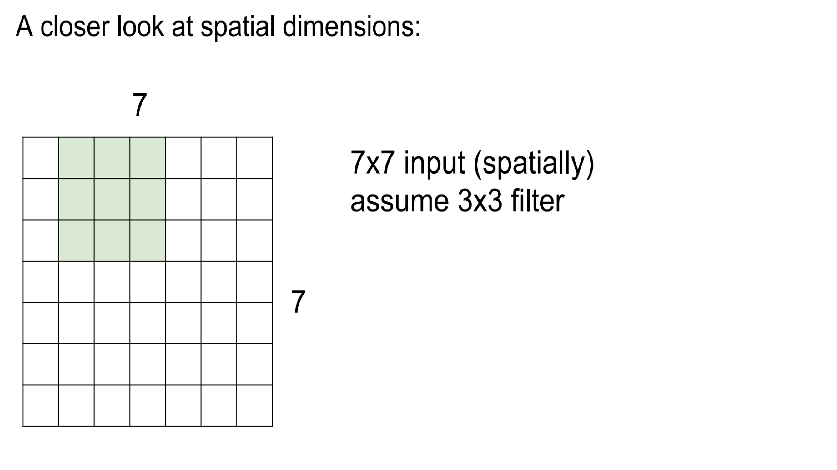

Slide 30
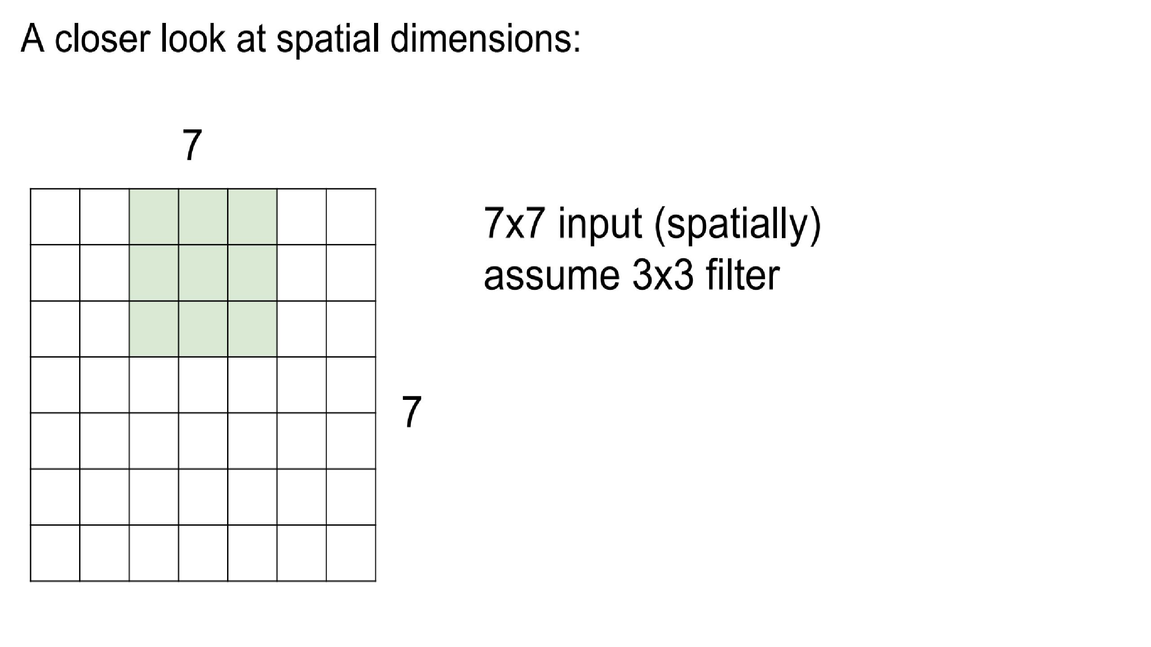

Slide 31
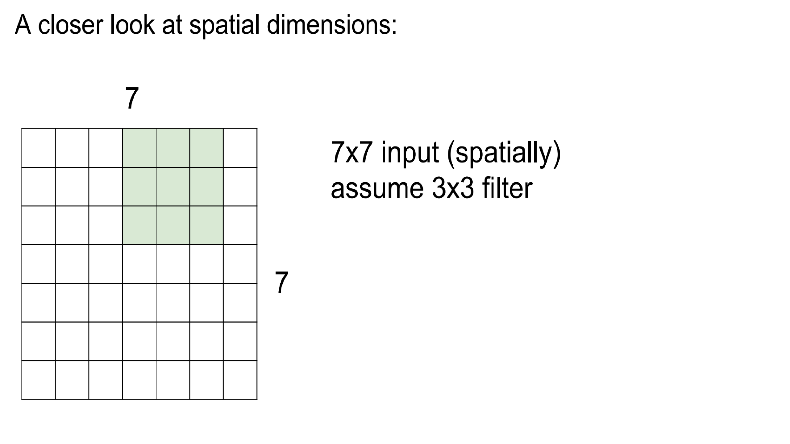

Slide 32
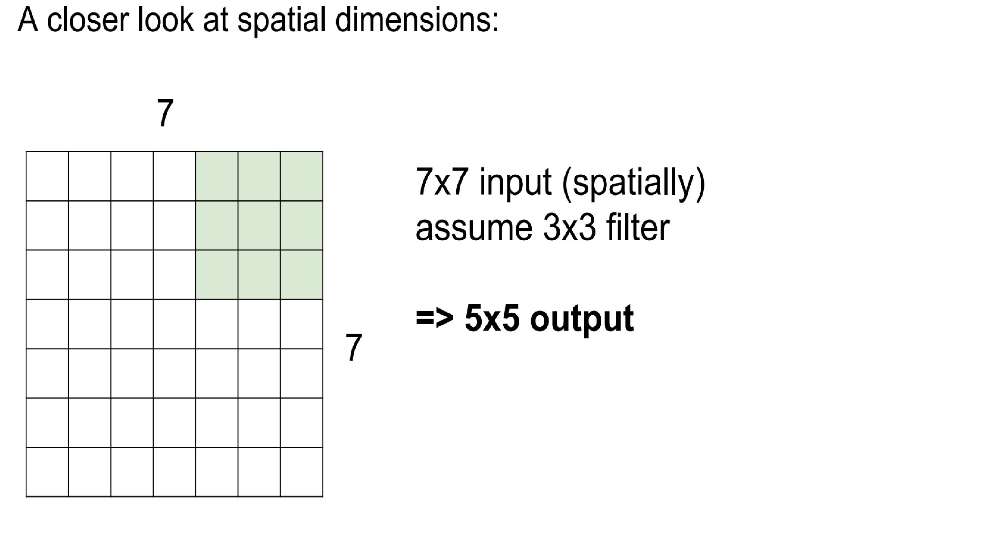

Slide 33
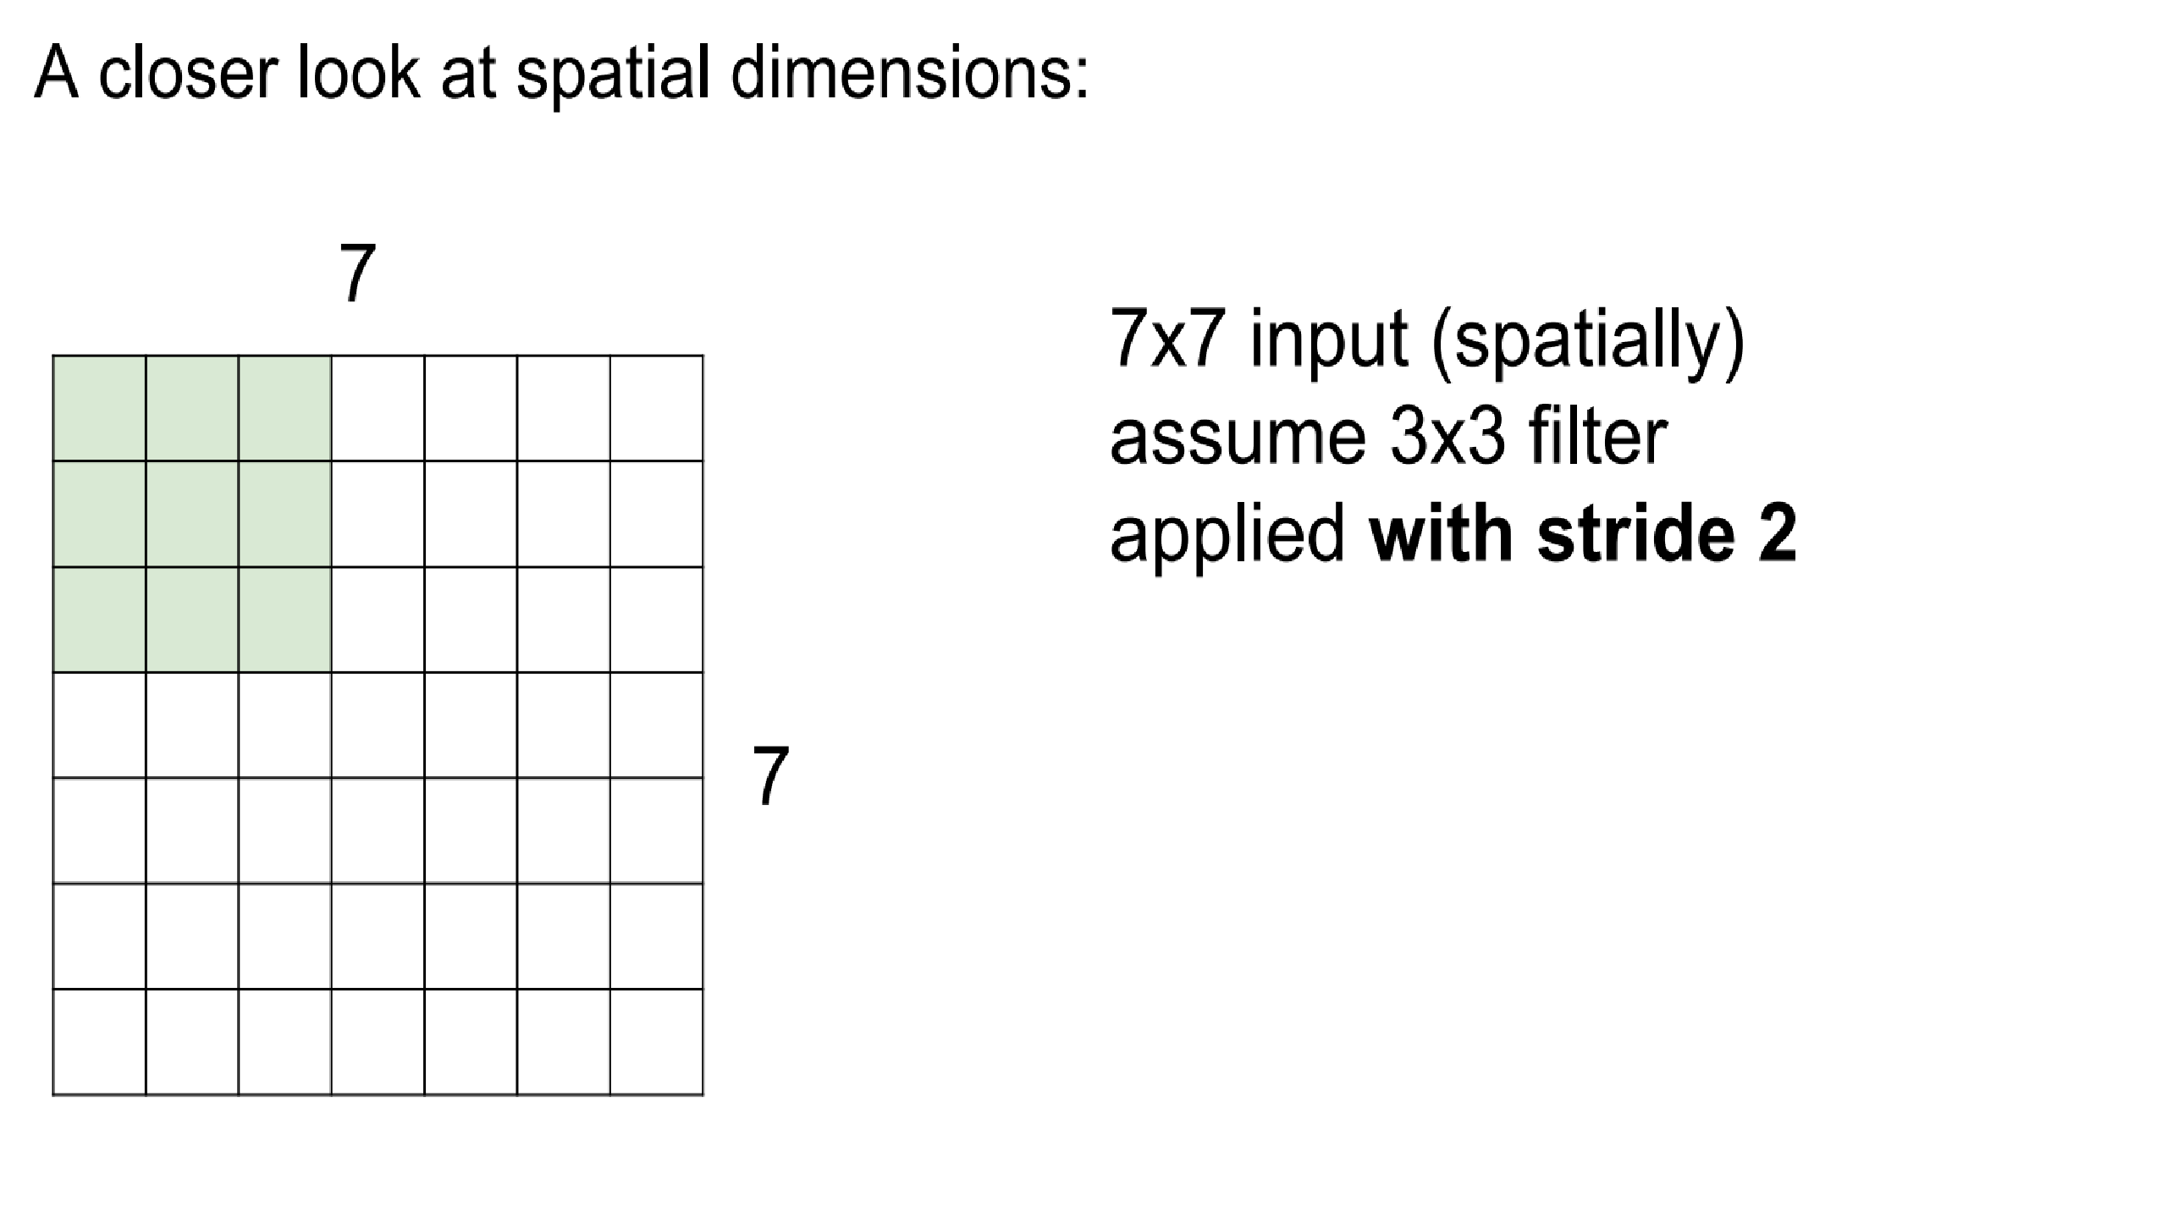

Slide 34
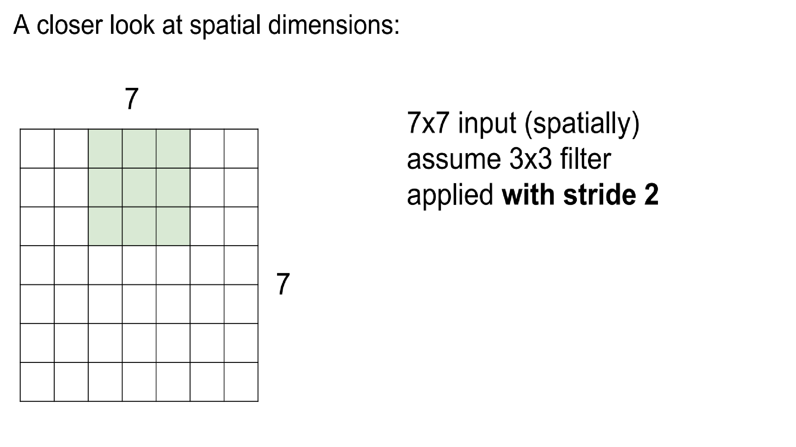

Slide 35
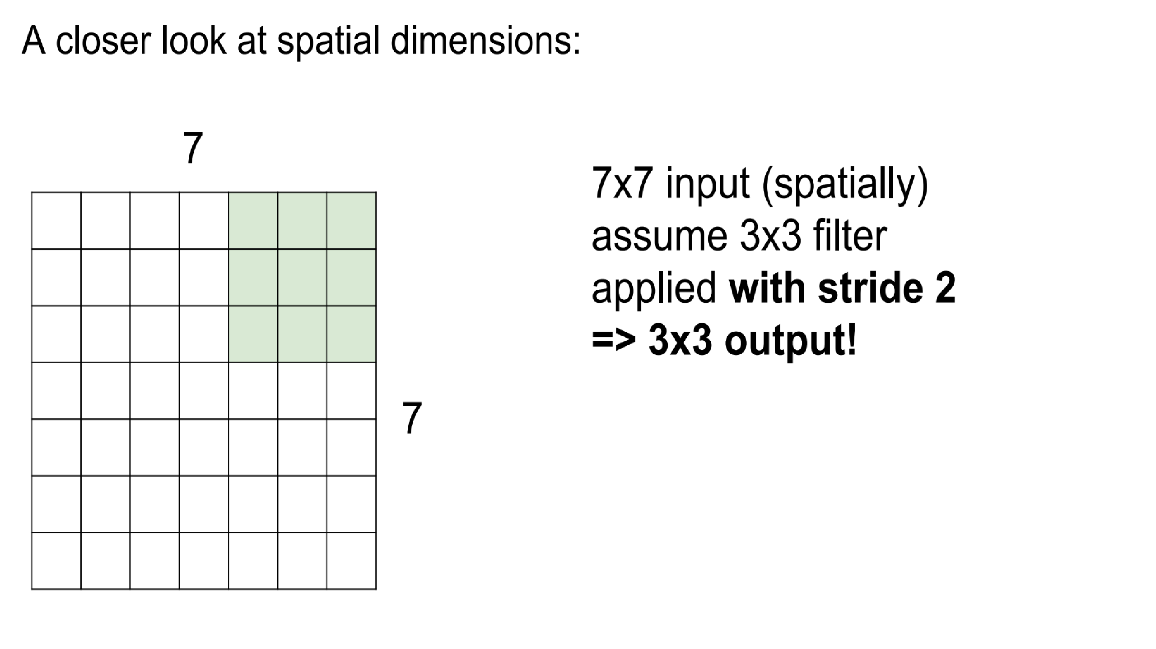

Slide 36
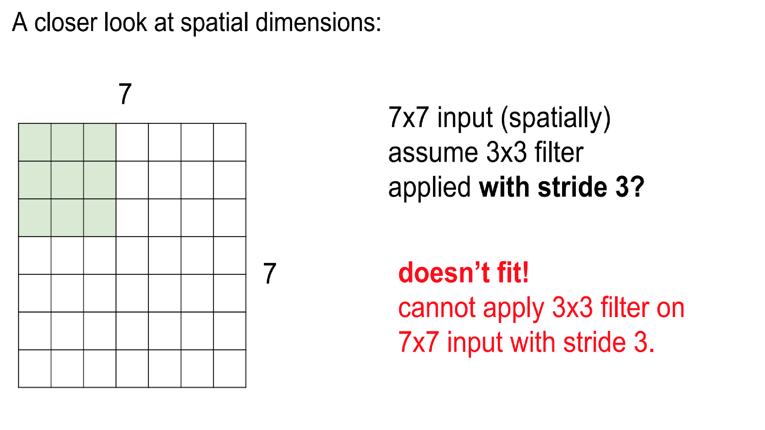

Slide 37
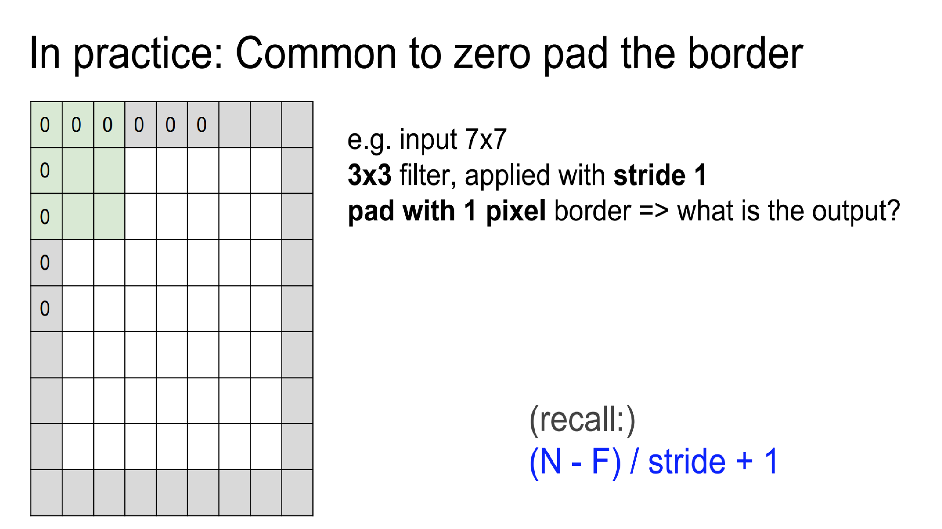

Slide 38
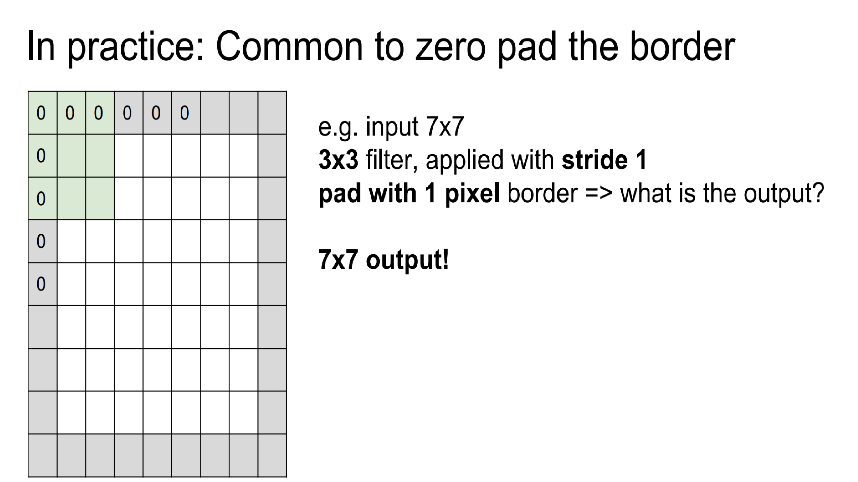

Slide 39
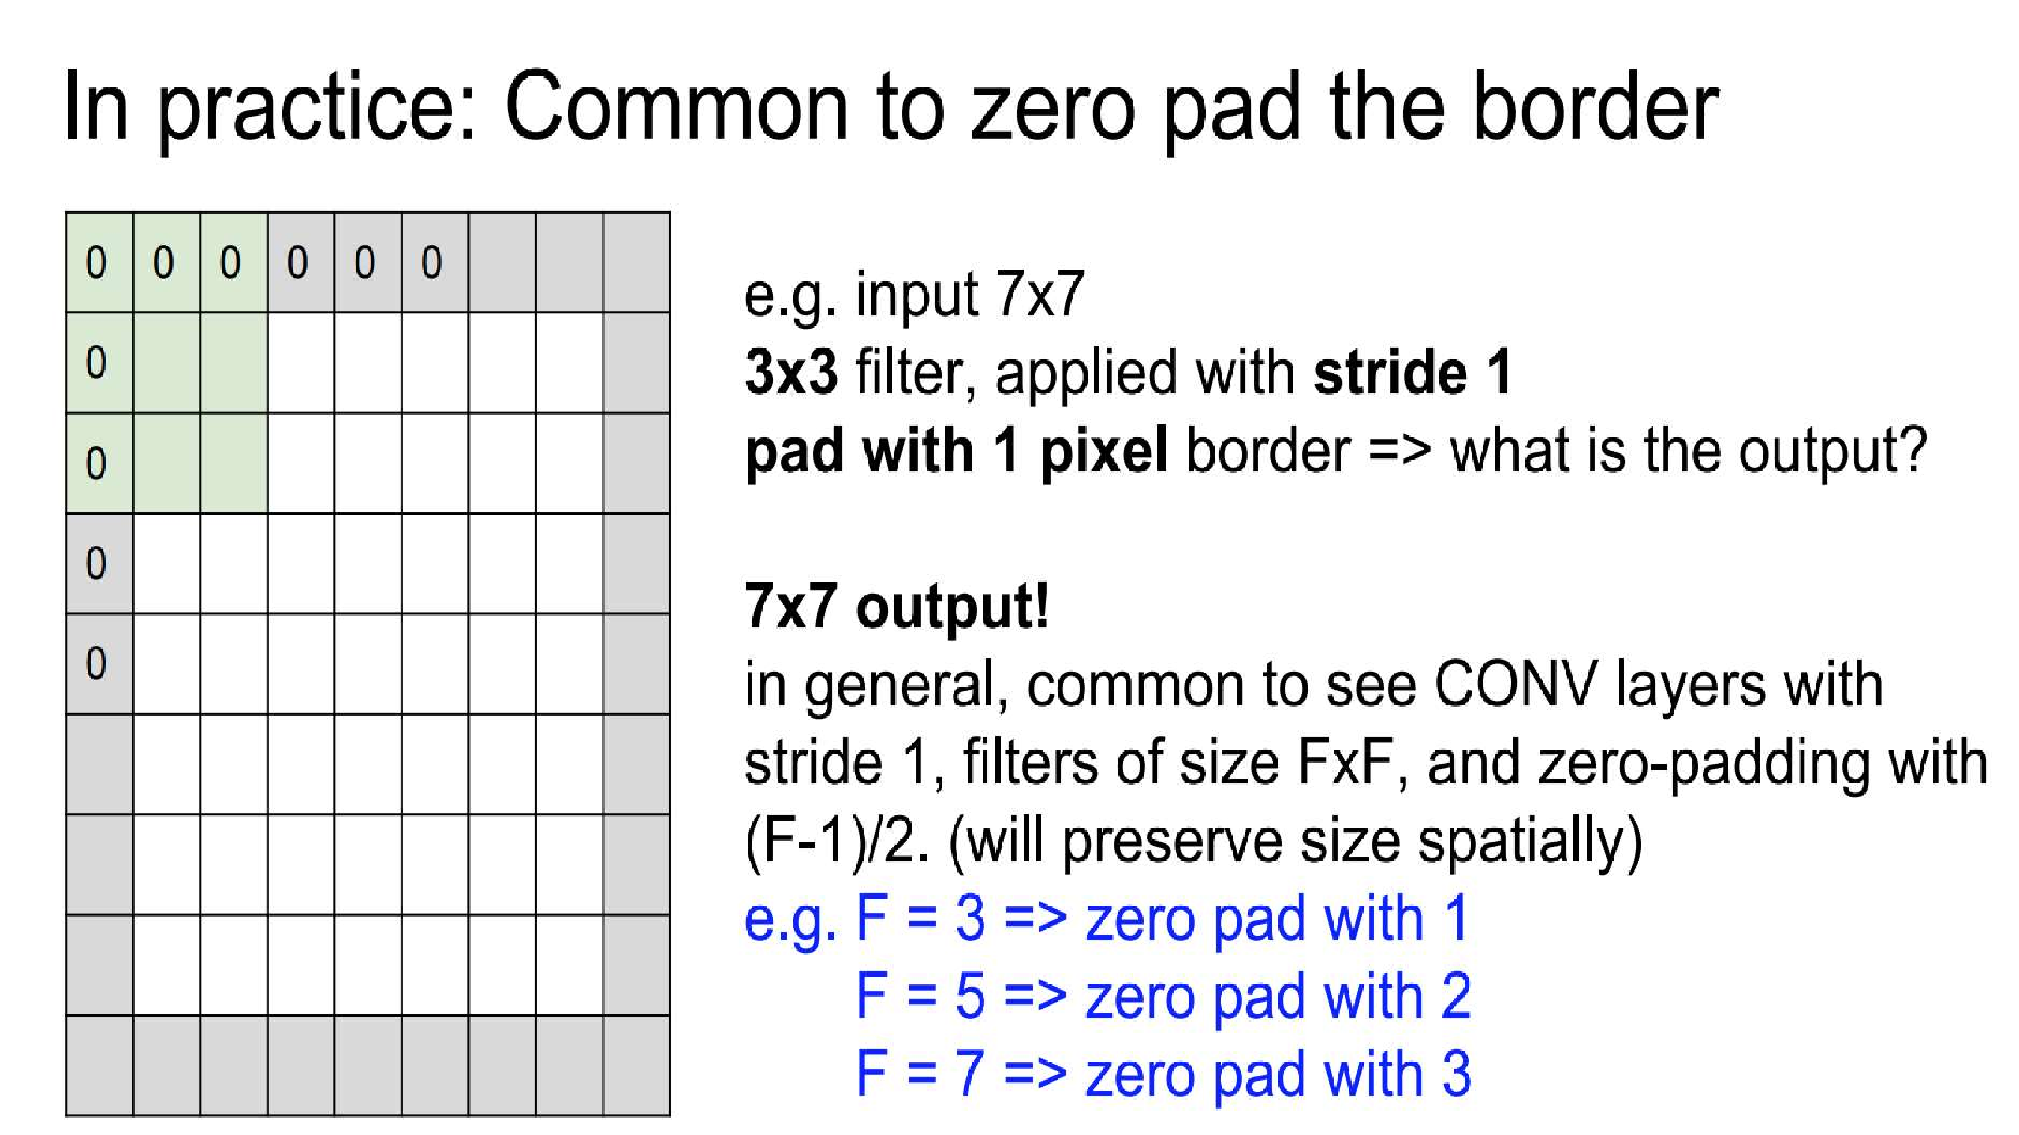

Slide 40
Pooling or Sub Sampling
Pooling (also called subsampling or downsampling) reduces the dimensionality of each feature map but retains the most important information
Pooling can be of different types: Max, Average, Sum etc.
Source: https://ujjwalkarn.me/2016/08/11/intuitive-explanation-convnets/

Slide 41
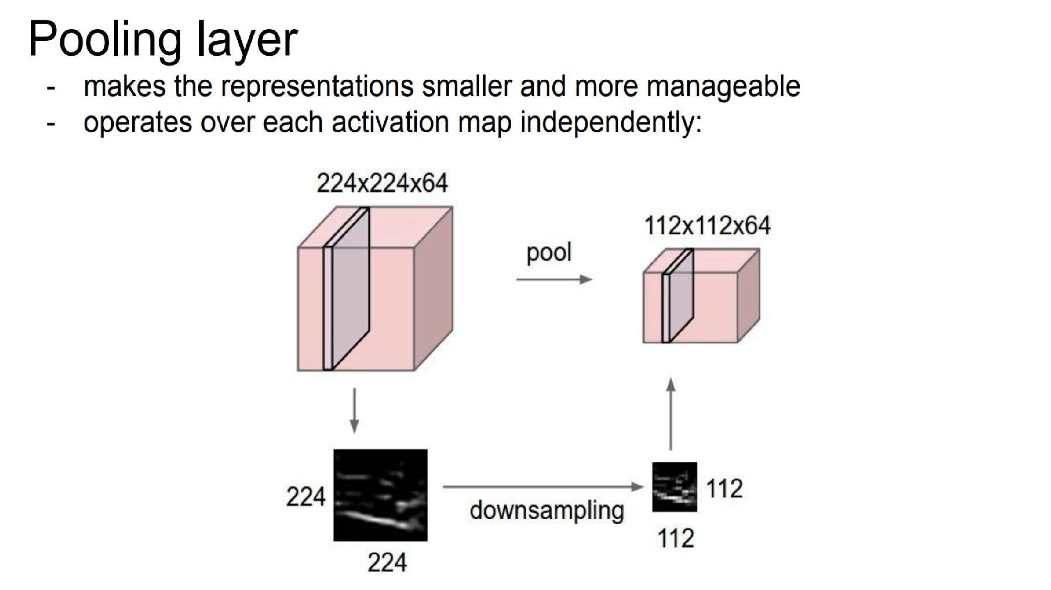

Slide 42
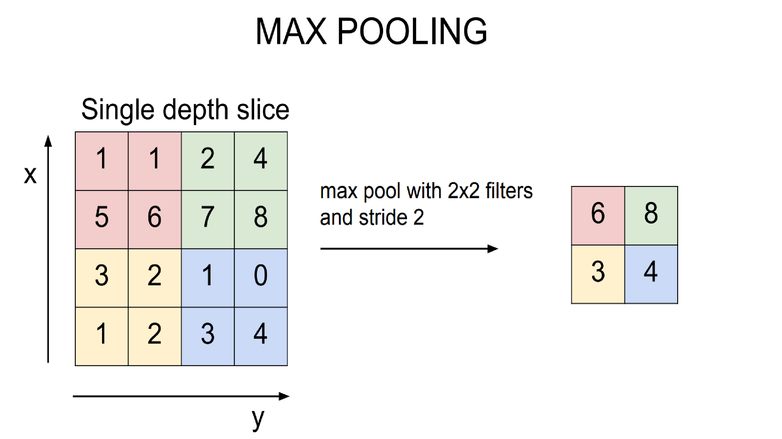

Slide 43



The whole CNN
cat dog ……
Convolution
Max Pooling
Can repeat
many times
Fully Connected Feedforward network
Convolution
Max Pooling
Flatten

Slide 44


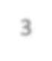
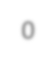
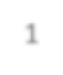



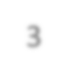
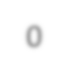


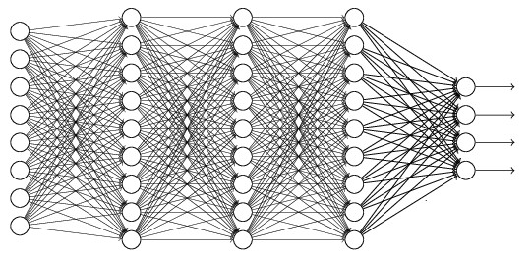
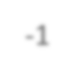
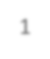
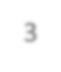





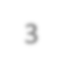
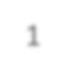
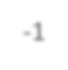

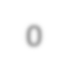

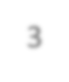

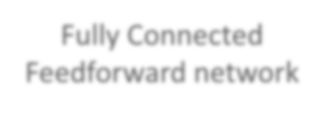
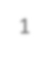


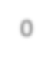

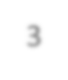
Flatten
3
0
1
3
-1
0
1
3
3 ₀ 1 ₃
-1
Flatten
1
Fully Connected Feedforward network
0
3

Slide 45




























+ 5
Input
Max
7
x₁
+
7
x₂
+
−1
Max 1
+
1
1 | 0 | 0 | 0 | 0 | 1
0 | 1 | 0 | 0 | 1 | 0
0 | 0 | 1 | 1 | 0 | 0
1 | 0 | 0 | 0 | 1 | 0
0 | 1 | 0 | 0 | 1 | 0
0 | 0 | 1 | 0 | 1 | 0
1 | -1 | -1
-1 | 1 | -1
-1 | -1 | 1
-1 | 1 | -1
-1 | 1 | -1
-1 | 1 | -1
convolution
Max pooling
image
(Ignoring the non-linear activation function after the convolution.)

Slide 46







+
Max
−1
Max
5
Input
7
x₁
+
7
x₂
+
1
+
1
1 | 0 | 0 | 0 | 0 | 1
0 | 1 | 0 | 0 | 1 | 0
0 | 0 | 1 | 1 | 0 | 0
1 | 0 | 0 | 0 | 1 | 0
0 | 1 | 0 | 0 | 1 | 0
0 | 0 | 1 | 0 | 1 | 0
1 | -1 | -1
-1 | 1 | -1
-1 | -1 | 1
-1 | 1 | -1
-1 | 1 | -1
-1 | 1 | -1
convolution
Max pooling
image
(Ignoring the non-linear activation function after the convolution.)

Slide 47

LAYERS IN CNN

Slide 48

Convolutional Neural Network
http://setosa.io/ev/image-kernels/

Slide 49
How to improve performance: Data Augmentation
increase the number of images in the dataset with the help of a method in Keras library named “ImageDataGenerator” by augmenting the images with horizontal/vertical flipping, rescaling, rotating and whitening etc.
The more data we have for training, the more accurate result we could obtain -here

Slide 50
Some famous CNN architectures!
LeNet-5 by Yann LeCun
AlexNet by Alex Krizhevsky et al.
GoogLeNet by Szegedy at Google Research
ResNet by Kaiming He et al.
Source: https://towardsdatascience.com/a-walkthrough-of-convolutional-neural-network-7f474f91d7bd

Slide 51
Use case: Image classification

Slide 52

Image Classification on Cifar10

Slide 53

Data set: Cifar10
containing 60.000 different images
size of all images in this dataset is 32x32x3 (RGB)

Slide 54
Load data set
(x_train, y_train), (x_test, y_test) = cifar10.load_data() y_train = to_categorical(y_train, num_classes) y_test = to_categorical(y_test, num_classes)
X_train /= 255.0
X_test /= 255.0
Using one hot encoding to transform the output variable into a binary matrix
Normalizing the data

Slide 55
structure of the model
We will use a structure with
two convolutional layers
followed by max pooling
and a flattening out of the network to fully connected layers to make predictions

Slide 56
Our baseline network structure can be summarized as follows:
Convolutional input layer, 32 feature maps with a size of 3×3, a rectifier activation function and a weight constraint of max norm set to 3.
Dropout set to 20%.
Convolutional layer, 32 feature maps with a size of 3×3, a rectifier activation function and a weight constraint of max norm set to 3.
Max Pool layer with size 2×2.
Flatten layer.
Fully connected layer with 512 units and a rectifier activation function.
Dropout set to 50%.
Fully connected output layer with 10 units and a softmax activation function

Slide 57
Convolutional layer
model = Sequential() model.add(Conv2D(32, (3, 3), padding='same', input_shape=x_train.shape[1:])) model.add(Activation('relu')) model.add(MaxPooling2D(pool_size=(2, 2))) model.add(Dropout(0.3))

Slide 58
Flatten layer
model.add(Flatten()) model.add(Dense(80)) model.add(Activation('relu')) model.add(Dropout(0.3)) model.add(Dense(num_classes)) model.add(Activation('softmax'))

Slide 59
Fitting model
model.compile(loss='categorical_crossentropy', optimizer=SGD, metrics=['accuracy']) model.fit(x_train, y_train, batch_size=batch_size, epochs=epochs, validation_split=0.2, shuffle=True) scores = model.evaluate(x_test, y_test, verbose=1) print('Test loss:', scores[0]) print('Test accuracy:', scores[1]) model.save('./model' + '.h5')

Slide 60
References
http://www.wildml.com/2015/12/implementing-a-cnn-for-text-classification-in-tensorflow/
https://towardsdatascience.com/a-walkthrough-of-convolutional-neural-network-7f474f91d7bd
http://cs231n.github.io/convolutional-networks/
https://www.youtube.com/watch?v=AgkfIQ4IGaM
https://adeshpande3.github.io/adeshpande3.github.io/A-Beginner's-Guide-To-Understanding-Convolutional-Neural-Networks/
https://www.youtube.com/watch?v=YRhxdVk_sIs

